Slide 1


Department of BES-1
Data structures
24SC1203
Topic:
Shell sort
Session - 1

Slide 2



AIM OF THE SESSION
To familiarize students with the basic concept of Shell Sort
INSTRUCTIONAL OBJECTIVES
This Session is designed to:
Demonstrate
Describe the working of shell sort technique
List out the steps of the shell sort algorithm
LEARNING OUTCOMES
At the end of this session, you should be able to:
Define Shell Sort
Describe an algorithm and time complexity of Shell Sort
Summarize the Shell Sort

Slide 3
SESSION INTRODUCTION
Shell sort is a generalized version of the insertion sort algorithm.
Got its name from the inventor by Donald Shell.
It first sorts elements that are far apart from each other and successively reduces the interval between the elements to be sorted.
Shell sort is implemented by using “Gap” sequence(N/2,N/4….1)
where Gap is a mathematical formula gap=N/2 and N is number of elements.

Slide 4
SESSION DESCRIPTION
Steps Involved in Shell sort-
Step 1: Set the gap value N/2 to j and first index set to i
Step 2: Compare i with j which is at the gap N/2
Step 3: increment i and j values
Step 4: Repeat step-2 until j reaches to end of the list up to this si pass-1.
Step 5: In pass-2 the gap value is gap=gap/2
Step 6: this procedure will continue until gap reaches to 1
Step7: when gap=1 shell sort work as insertion sort
Step8: Using insertion sort the entire list would be in sorting order

Slide 5
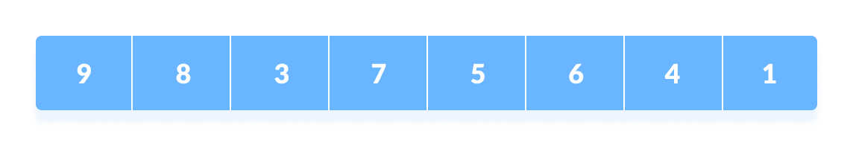
SESSION DESCRIPTION (Cont..)
Working of Shell Sort
Suppose, we need to sort the following array
We are using the shell's original sequence (N/2, N/4, ...1) as intervals in our algorithm.
In the first loop, if the array size is N = 8 then, the elements lying at the interval of N/2 = 4 are compared and swapped if they are not in order.
The 0th element is compared with the 4th element.

Slide 6
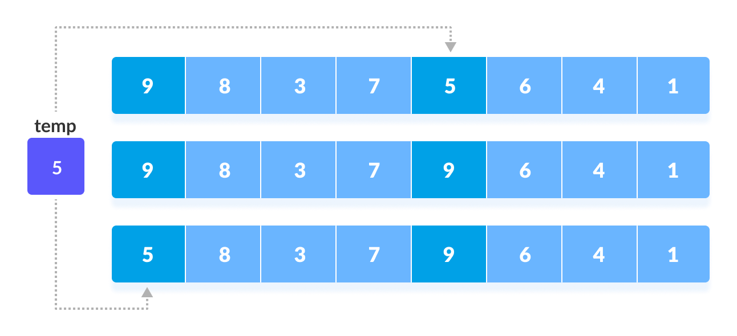
SESSION DESCRIPTION (Cont..)
If the 0th element is greater than the 4th one then, the 4th element is first stored in temp variable and the 0th element (ie. greater element) is stored in the 4th position and the element stored in temp is stored in the 0th position.

Slide 7
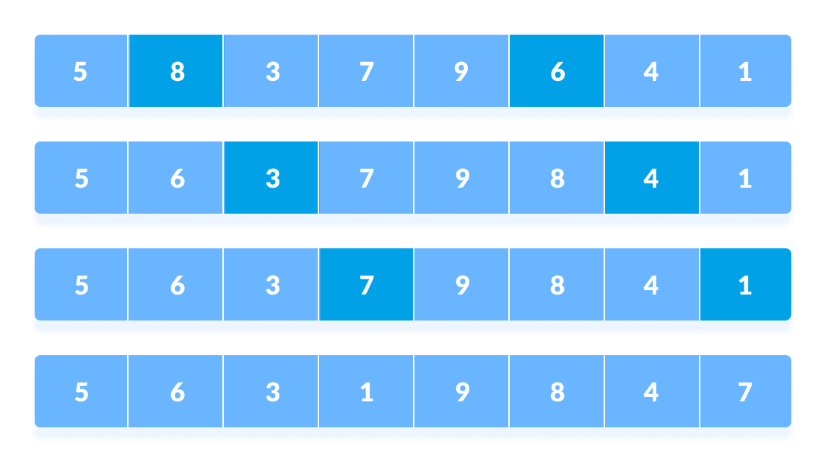
SESSION DESCRIPTION (Cont..)
This process goes on for all the remaining elements.

Slide 8
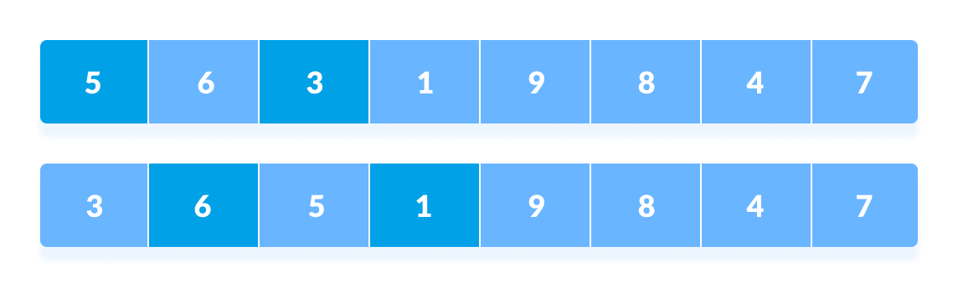
SESSION DESCRIPTION (Cont..)
In the second loop, an interval of N/4 = 8/4 = 2 is taken and again the elements lying at these intervals are sorted
The elements at 4th and 2nd position are compared. The elements at 2nd and 0th position are also compared. All the elements in the array lying at the current interval are compared.

Slide 9
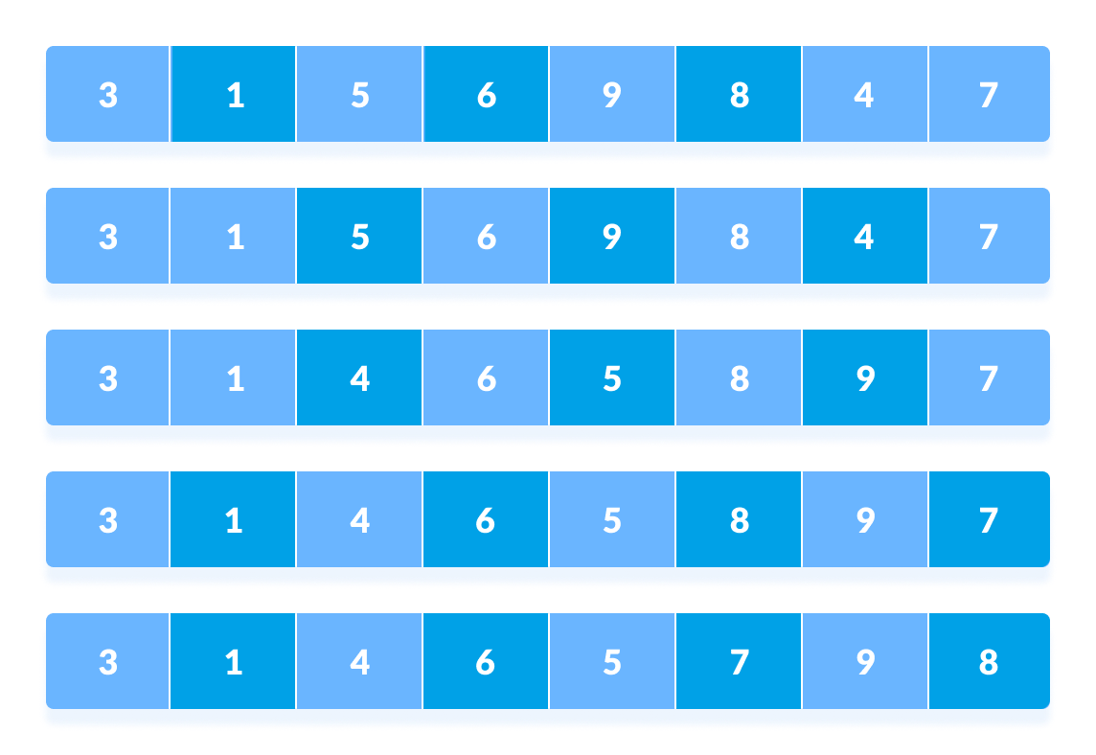
SESSION DESCRIPTION (Cont..)
The same process goes on for remaining elements

Slide 10
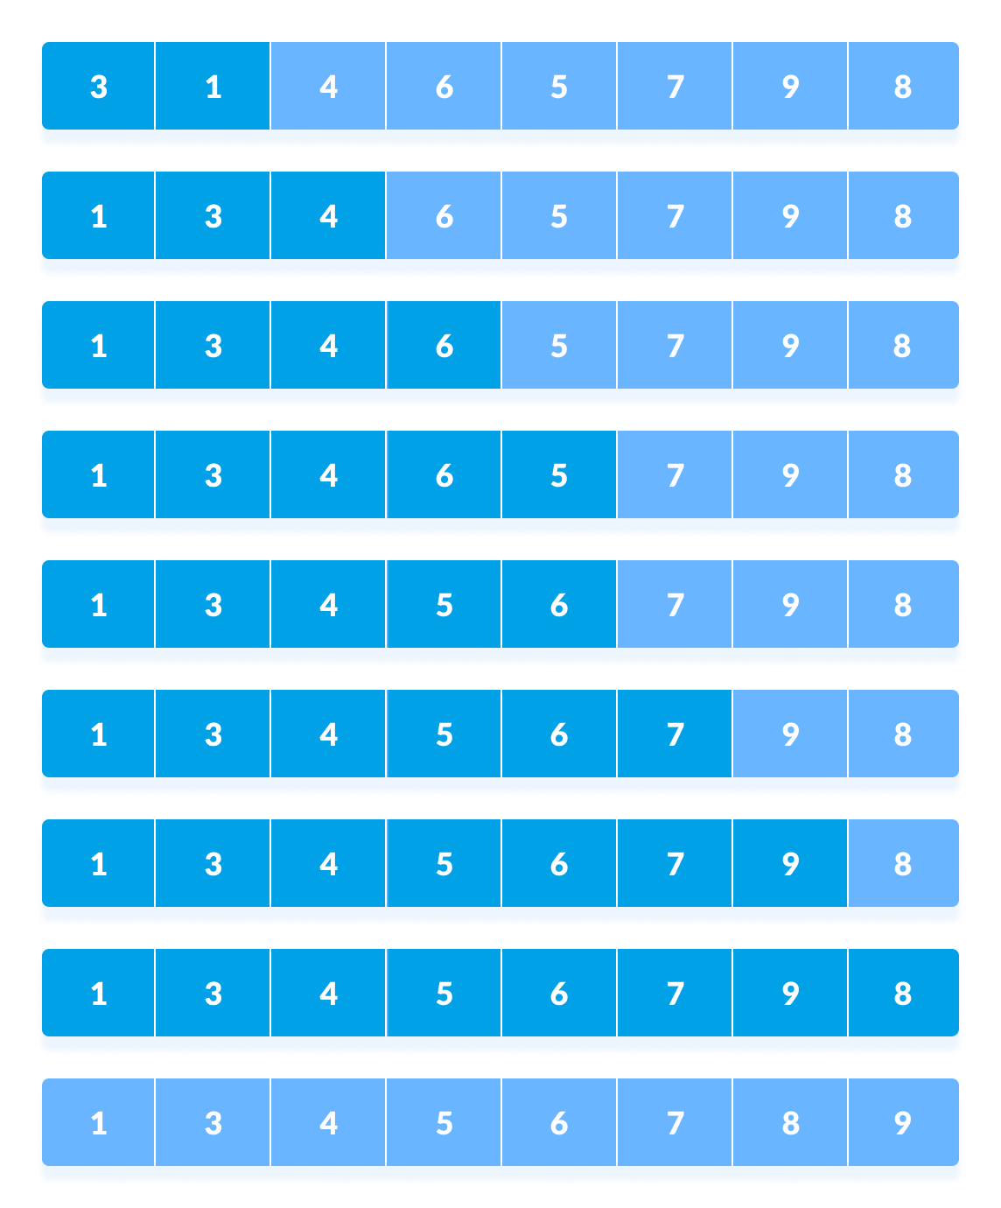
SESSION DESCRIPTION (Cont..)
Finally, when the interval is N/8 = 8/8 =1 then the array elements lying at the interval of 1 are sorted. The array is now completely sorted.

Slide 11
SESSION DESCRIPTION (Cont..)
Shell Sort Algorithm Pseudocode
Procedure begin: Shell sort
Calculate gap size ($gap)
WHILE $gap is greater than 0
FOR each element of the list, that is $gap apart
Extract the current item
Locate the position to insert
Insert the item to the position
END FOR
Calculate gap size ($gap)
END WHILE
End procedure
Note: Initially the $gap is half of length of the array and the $gap size is recalculated by dividing the gap by 2 every time

Slide 12
SESSION DESCRIPTION (Cont..)
Complexity of Shell Sort Algorithm
Complexity in the Best Case: O(n*Log n)
Complexity in the Average Case: O(n*log n)
Complexity in the Worst-Case Scenario: O (n2)

Slide 13
ACTIVITIES/ CASE STUDIES/ IMPORTANT FACTS RELATED TO THE SESSION
Since Shell sort can be implemented using little code and does not use the call stack, some implementations of the qsort function in the C standard library targeted at embedded systems use it instead of quicksort. Shell sort is, for example, used in the uClibc library. For similar reasons, an implementation of Shell sort is present in the Linux kernel.
Shell sort can also serve as a sub-algorithm of introspective sort, to sort short subarrays and to prevent a slowdown when the recursion depth exceeds a given limit. This principle is employed, for instance, in the bzip2 compressor.

Slide 14
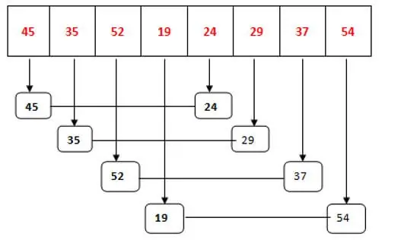
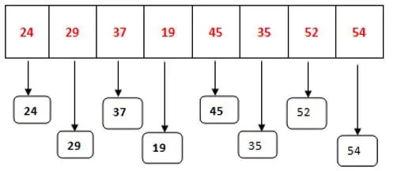


EXAMPLES

Slide 15
SUMMARY
Shell Sort is mainly a variation of Insertion Sort. In insertion sort, we move elements only one position ahead. When an element has to be moved far ahead, many movements are involved. The idea of Shell Sort is to allow the exchange of far items. In Shell sort, we make the array h-sorted for a large value of h. We keep reducing the value of h until it becomes 1. An array is said to be h-sorted if all sublists of every h^{th} element are sorted.

Slide 16
SELF-ASSESSMENT QUESTIONS
What is the other name for a shell sort algorithm?
Diminishing increment sort
Diminishing decrement sort
Insertion Sort
Selection Sort
The worst case running time of shell sort, using Shell’s increments is?
O(N)
O(N log N)
O(log N)
O(N²)

Slide 17
TERMINAL QUESTIONS
1. Describe what is Shell sort
2. List out steps involved in Shell sort
3. Analyze complexity of Shell sort
4. Summarize the working principle of Shell sort

Slide 18
REFERENCES FOR FURTHER LEARNING OF THE SESSION
Reference Books:
1. . Data Structure Through C by Yashavant P. Kanetkar
2. Algorithms in a Nutshell by George T. Heineman, Gary Pollice and Stanley Selkow
Sites and Web links:
1. https://www.javatpoint.com/shell-sort

Slide 19
THANK YOU
Team – Data Structure

